Slide 1
Python Project
Presentation Slide Samples

Slide 2
Team Members
Member 1: Joshua
Member 2: Rachel

Slide 3
Team VCS
GitHub Link
https://github.com/Josheaaa/main.py

Slide 4
Responsibilities
Joshua
Statistics
The mean number of visitors from China/Indonesia/Japan in 2002 to 2005
Charts
preparing pictures of charts

Slide 5
Responsibilities
Rachel
Setting up GitHub Repository
Unit Testing
Setting up power point

Slide 6
Team Findings
Top 3 countries in (Asia) over (1998 - 2007)
Country | Total Visitors
Indonesia | 15,015,386 Visitors
Japan | 6,923,674 Visitors
China | 6,725,551 Visitors

Slide 7
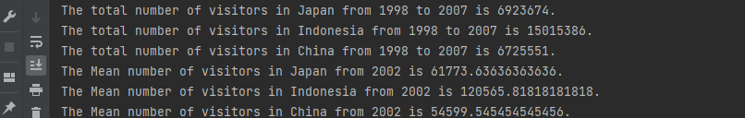
Statistics ( Joshua )
The total number of visitors in Japan/Indonesia/China from 1998 to 2007
The Mean number of visitors in Japan/Indonesia/China from 1998 to 2007

Slide 8
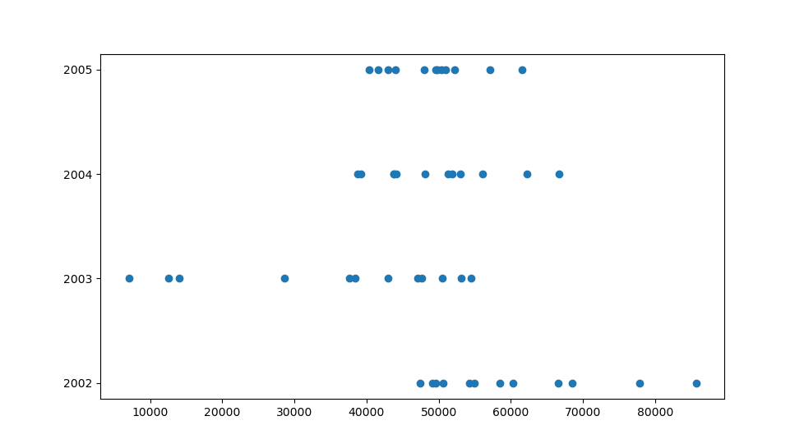
Charts ( Joshua )
As we can see the number of visitors from 2002 to 2005

Slide 9
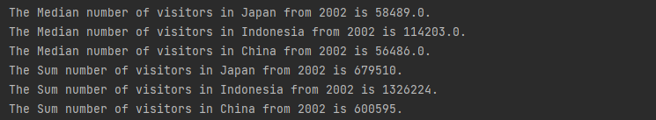
Statistics (Rachel)
The Median number of visitors in Japan/Indonesia/China from 2002 Jan to Dec
The Sum of numbers of visitors in Japan/Indonesia/China from 2002 Jan to Dec

Slide 10
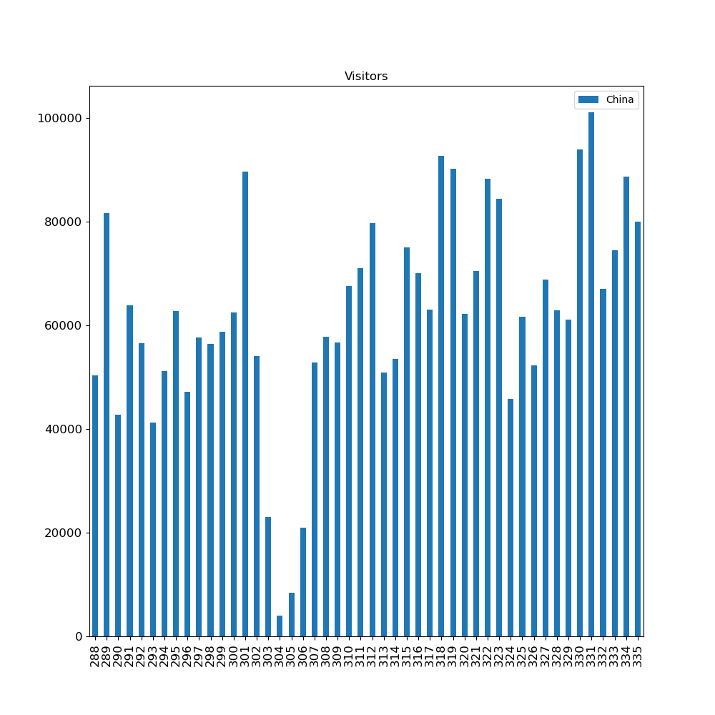
Charts ( Rachel )
As we can see the number of visitors from 2002 to 2005

Slide 11
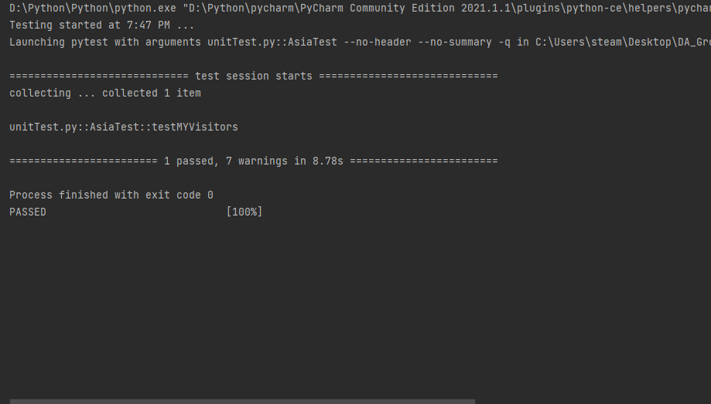
Team Unit Test
The name is unitTest.py
To check if it sums up the number of China correctly
The results show a pass

